Slide 1
Critical Design Review
CubeSat | Control
MECH/ECE 4000 – Product Design I
4 Dec 2024
Ben Sherman
Trace Shafer
Lauric Brown
Micah Gifford

Slide 2
Overview
Design Statement
Design Requirements
Metrics Check
Mechanical System Review
Assembly Plan
Electrical System Review
Electronic Component Spec Sheet
Software System Review
Testing
Control Analysis Results
Fabrication Plan
Budget/Bill of Materials
Schedule

Slide 3




Design Statement
Stakeholders: Utah NASA Space Grant Consortium, Utah Division of Water Resources
Sponsors: RAM, PTC, Washington County and Water Conservancy District
Design statement: Design, prototype, and evaluate attitude control system to point at a set location on Earth while taking a photo from low Earth orbit.
Notes:
Talking Points:
State who your sponsor is and give a short background
Read the design statement verbatim
Give the 1000-foot view of the project.

Slide 4
Design Requirements
Design Requirements | How is it satisfied
Total Contingency Weight: 1kg | 752.64 grams
Total Power allocation: 13 W | Currently planning to use 3W
Cleanliness Requirements | Wear gloves and facemasks when handling flight hardware to ensure parts are handled with care

Slide 5
Metrics Check
Status | Metric | Description | Units | Acceptable Range | PDR | CDR
F | Weight | Total Contingency Weight | g | 752.64 | 752.64 | 752.64
F | Rotate to Fix blur | The CubeSat will need to rotate while taking a picture to stop the blur | rad | 0.288 | 0.288 | 0.288
F | Sun Sensor | Locates the sun and is required to back up star tracker (response time) | ms | <10 | 6e-5 | 6e-5
F | IMU | Tracks acceleration (accuracy) | Gravity force | -16 to 16 | Acceptable values found in datasheet | Acceptable values found in datasheet
F | Magnetometer | Range to cover earths magnetic field | microtesla | 20 to 10000 | Acceptable values found in datasheet | Acceptable values found in datasheet
F | Magnetic dipole | Magnetorquers ability to create a magnetic dipole | Am^2 | 0.1 to 10 | 0.128 | 0.128
F | FOV | Star Tracker camera | deg | 5 to 40 | 40 | 40
Notes:
Notes:
List your talking points with details. You will not read from these notes and these notes may contain information that you forget to mention in your presentation.
Everything needs to be in bullet point form and put in presenting order.

Slide 6
Metrics Check
Status | Metric | Description | Units | Acceptable Range | PDR | CDR
F | Pointing Accuracy | How accurately the attitude and control can be maintainted in a desired direction | deg | 0.1 to 1 | 0.8662 | 0.8662
F | Rotating Accuracy | How accurately the cubesat is able to rotate | mrad | 0.1 to 1 | 0.228 | 0.288
F | Power Consumption | How power is required for the entire subsystem | Watts | <13 | 3 | 3
F | Operational Temp Range | Temperature range for the components to operate in | C | -40 to 85
F | Budget | Budget for the Control Subsystem | $ | <1500 | 1013.54 | 1013.54
F | Angular Velocity (Rotating) | How fast cubesat will need to move to complete rotation to take picture | rad/s | 0.01 to 0.1 | 0.0183 | 0.0183
Notes:
Notes:
List your talking points with details. You will not read from these notes and these notes may contain information that you forget to mention in your presentation.
Everything needs to be in bullet point form and put in presenting order.

Slide 7
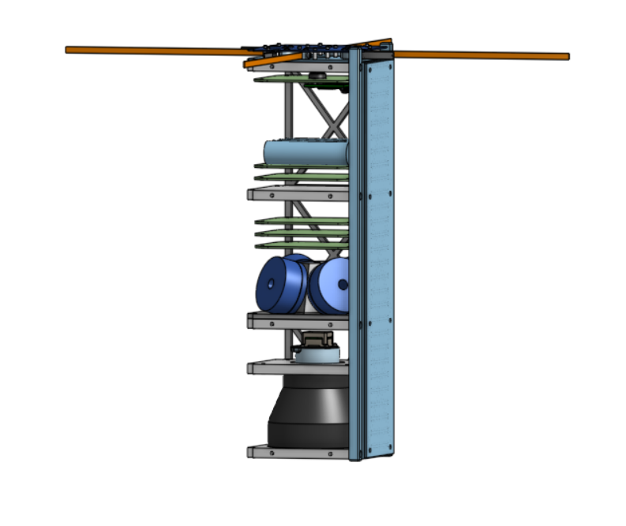
Mechanical System Review
Required program:
Onshape
Star Tracker
Magnetorquers x4
Sun Sensor x4
Control Board
Reaction Wheels

Slide 8
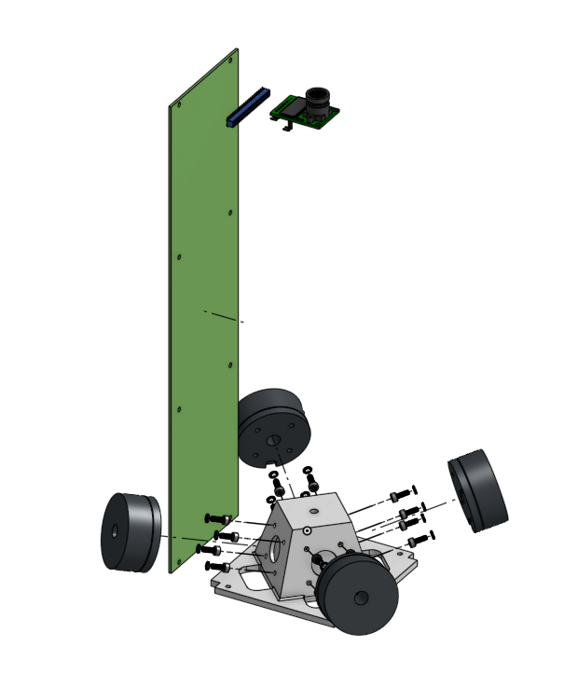
Assembly Plan
This is how our assembly is going to get put together
Four reaction wheels mounted to the pyramid base
16 bolts and 16 washers are attached to the reaction wheels through the base

Slide 9
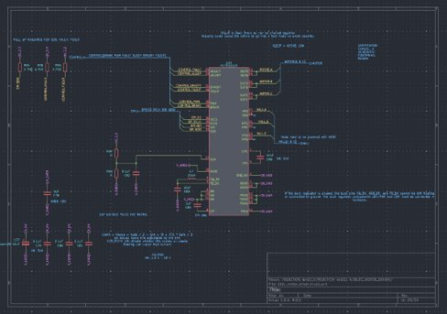
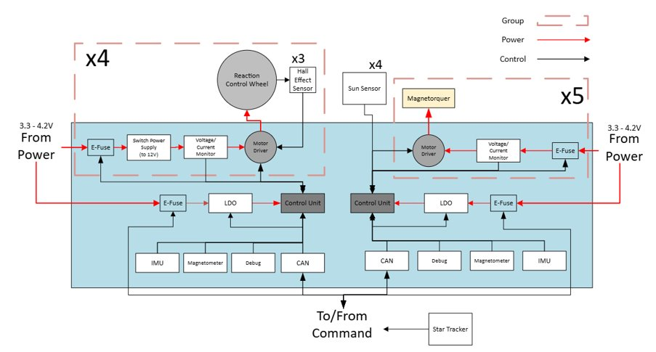
Electrical System Review
Everything will be soldered onto the board
PCB will plug into the CubeSat frame
Notes:
Explicit Images (if they pertain to your project)
Wiring Diagram
Circuit Schematic
PCB Design
Programs that can assist you are:
Fritzing / TinkerCAD Electronics
LTSpice
KiCAD

Slide 10
Electronic Component Spec Sheet
Component | Max Power (W*h/orbit) | Planned Power (W*h/orbit) | Voltage (V) | Current (μA) | Allowable Temp (°C)
Sun Sensor | 0.0008925 | 0.0000425 | 0.9 | 7 | -40 to +110
Star Tracker | 1.5 | 0.1 | 5 | 20,000 | -10 to +55
Magnetometer | 0.001377 | 0.000891 | 1.8 | 270 | -40 to +85
IMU | 0.2805 | 0.002145 | 1.8 | 550 | -40 to +85
Microcontroller | 0.5022 | 0.0165 | 3.3 | 18.5 | -40 to +85
DC Motor | 19.8 | 0.55 | 10 | 1.1*10^6
Motor Driver | 2.16 | 0.12 | 10 | 18,000 | -40 to +125
Magnetorquer | 0.00139 | 55.6*10^-6 | 3.3 | 420 | -50 to +90
Notes:
Create a table for each board that shows each electronic component spec sheet values for power, voltage, current, temperature allowables vs CubeSatorbit maximum power, voltage, current, and temperatures
•Need to clearly demonstrate derating margin
•Table will show for each component, the type of component, the allowables, and the operational values

Slide 11
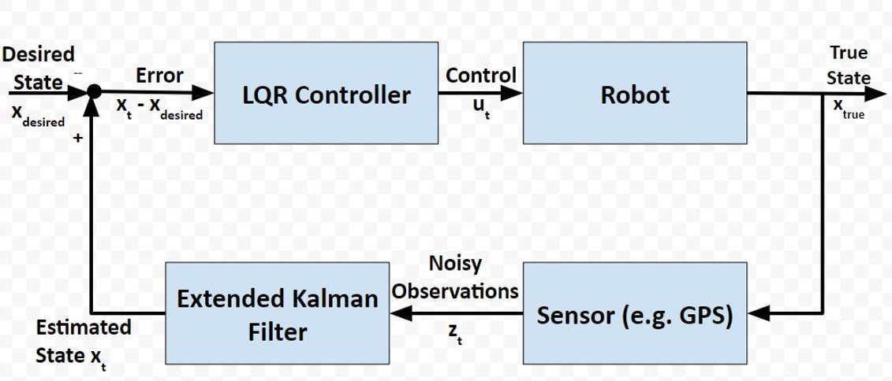
Software System Review
Code simulation created in Matlab
Will be used as a reference when Rust code is written
CubeSat
Notes:
•Clearly indicate the software that comes with your subsystem and the software that will be needed to interface with your subsystem
•Clearly indicate expected lines of code, the software that will be used, and who will write the code

Slide 12
Testing
Test | Components being tested
Hang by fishing line | Actuators
Hold in hand and move it around | IMU and magnetometer
Project stars and check star tracker | Star tracker
Temperature cycling test, –25 to 25C | Entire system
Bakeout at 100 C for 24 hours | Entire system
Random vibration test at 100 Grms | Entire system
Hold up to sun | Sun sensors
Run simulation on Matlab with noise | Control algorithm

Slide 13
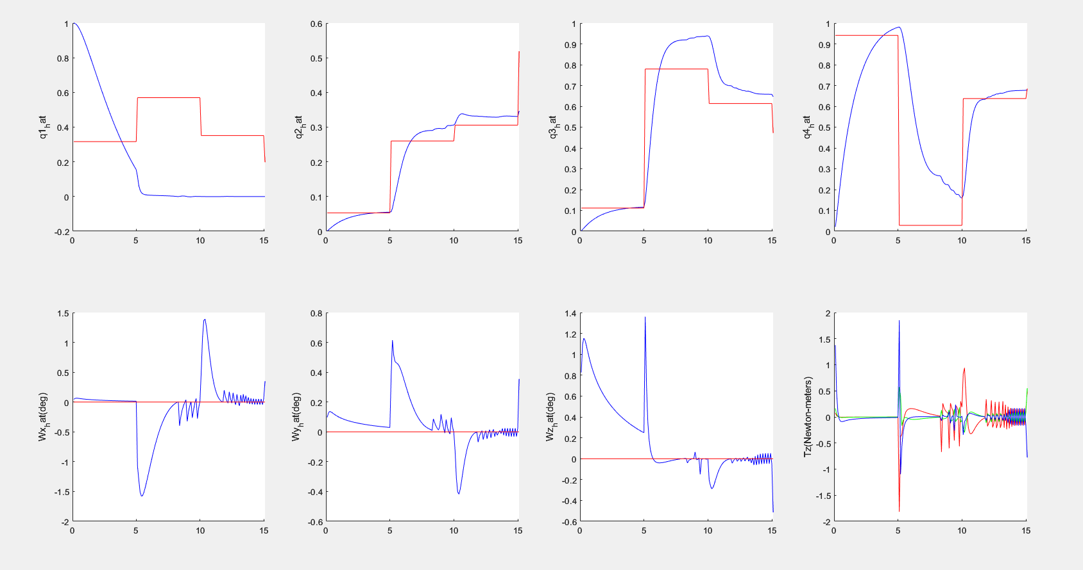
Control Analysis Results
Notes:
•Determine if any transient or overshoot occurs when CubeSat rotates to target
•Plot reaction wheel (RW) torque, CubeSat angular acceleration, angular velocity, and rotation vs time at sensor (IMU?) used to determine CubeSat position. Also, plot RW torque/angular velocity

Slide 14
Fabrication Plan
Custom Part | Process(es) Required for Fabrication | Link to File | Costs
Reaction Wheel Mount | CNC Mill | OnShape | Tooling - $150 6061 Aluminum Block
Tooling Requirements
We will need to purchase an angle cutter for the CNC to make our motor mount. Utah Tech has the rest of the tooling we need.
Notes:
Notes:
List your talking points with details. You will not read from these notes and these notes may contain information that you forget to mention in your presentation.
Everything needs to be in bullet point form and put in presenting order.

Slide 15
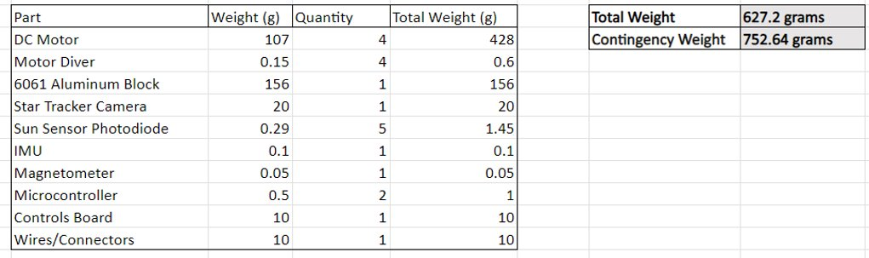
Weight (Allocated 1kg)

Slide 16
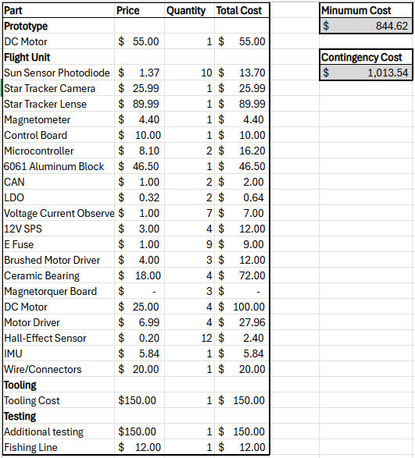
Budget
Budget: $1500
Bill of Materials
Notes:
Notes:
List your talking points with details. You will not read from these notes and these notes may contain information that you forget to mention in your presentation.
Everything needs to be in bullet point form and put in presenting order.

Slide 17
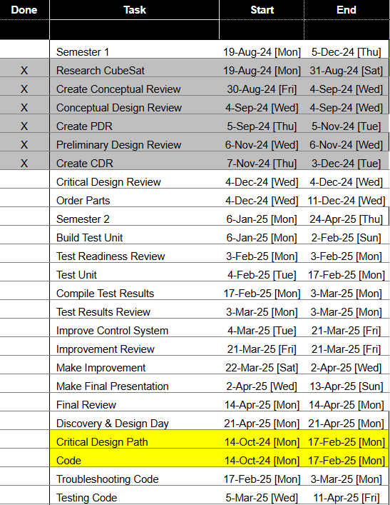
Schedule
Control Gannt Chart
Notes:
Talking Points:
Discuss your detailed schedule leading up to Test Readiness Review
Point out series and parallel tasks & defend overall arrangement of tasks

Slide 18
Questions

